Slide 1
RATINGS PREDICTION PROJECT
Submitted by:
Pritam Sangle

Slide 2
PROJECT OVERVIEW
Business Problem Framing
Conceptual background of the Domain Problem
Data Sources & Formats
EDA
Data Preprocessing
Data Visualization
Testing of Identified Approaches
Interpretation of Results
Limitations & Scope for Future Work

Slide 3
BUSINESS PROBLEM FRAMING
The proliferation of social media enables people to express their opinions widely online. However, it is a review of a product or service where it reflects the opinions and experiences of a customer purchasing a product or service. For customers, online reviews and testimonials are all about building trust. And that’s especially true for ecommerce sales when shoppers can’t ask store associates for product information before buying.
We have a client who has a website where people write different reviews for technical products. Now they are adding a new feature to their website i.e. the reviewer will have to add stars (rating) as well with the review. The rating is out 5 stars and it only has 5 options available 1 star, 2 stars, 3 stars, 4 stars, 5 stars. Now they want to predict ratings for the reviews which were written in the past and they don’t have a rating. So, we have to build an application which can predict the rating by seeing the review.

Slide 4
CONCEPTUAL BACKGROUND OF THE DOMAIN PROBLEM
Online reviews build brand trust among the audience. If potential customers know that other people had positive experiences with a brand, they’re more likely to trust the brand. Reviews build brand credibility and increase the likelihood that consumers will purchase from that brand.
Online reviews also validate the company’s expertise in the eyes of prospective customers. They prove that the brand/company has successfully helped other people overcome a specific challenge or accomplish a particular goal.
Anyone can make claims about how amazing their product or service is, but that doesn’t mean those claims are true. By providing evidence of success through online reviews, brands can demonstrate their expertise and authority.
Most consumers trust online reviews by their peers more than the claims made by a company. Consumers are less likely to believe a claim if there isn’t any third-party supporting evidence. Good reviews are a great way to back up any claims made by a company.

Slide 5
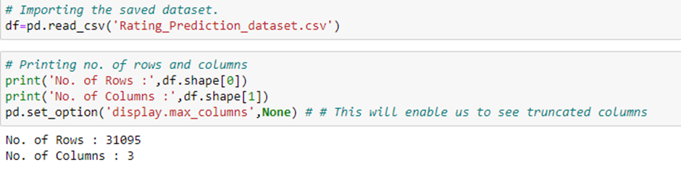
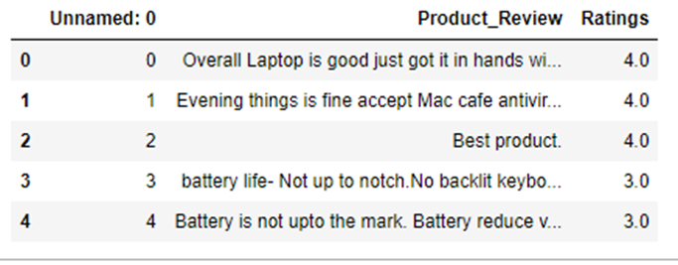
DATA SOURCES & FORMATS
The data set is scrapped from online shopping websites like Amazon and Flipkart. The dataset contains 31095 rows and 3 columns. These are enclosed in CSV format. All the data samples contain 3 fields which includes ‘Unnamed:0, ‘Product_Review’ and ‘Ratings’.
Here, 1 = Poor.
2 = Fair.
3 = Good.
4 = Very Good.
5 = Excellent.

Slide 6
Exploratory Data Analysis (EDA)
We dropped the ‘Unnamed: 0’ column because it was unnecessary for our prediction.
We observe that the ‘Product_Review’ column is an object datatype & the Ratings column is a float datatype.
It also came to our notice that there were certain null values in the Product review column.

Slide 7
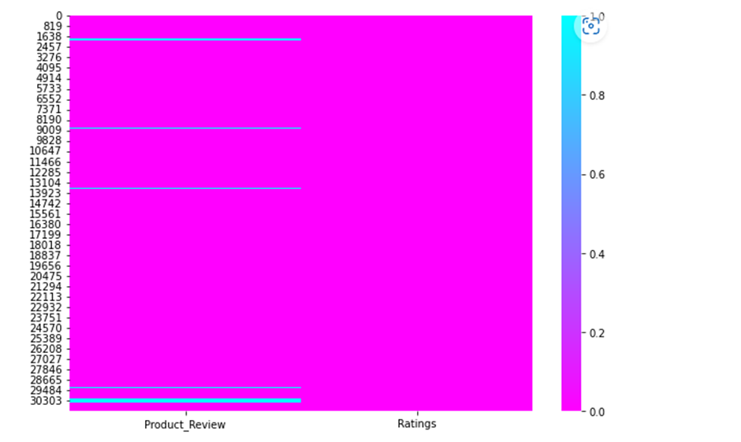

DATA PREPROCESSING
We found missing reviews as illustrated by the heatmap.
We replaced the missing values in product reviews with 'Review Not Available'.
We also applied the following steps as a part of text mining:
→Removing Punctuations and other special characters
→Word Tokenzation
→Removing Stop Words
→Stemming and Lemmatising
→Applying Count Vectorizer

Slide 8
DATA VISUALIZATION

Slide 9
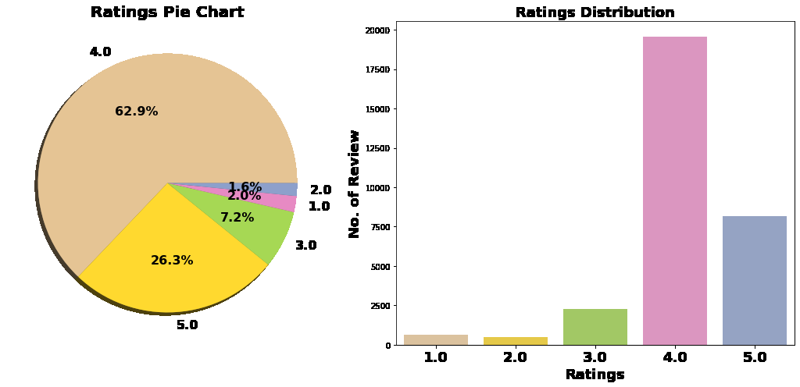
We can see that Rating 4 has the highest count followed by Rating 5, 3, 1, 2.
Value Counts of Rating:
4.0 19556
5.0 8167
3.0 2250
1.0 622
2.0 500

Slide 10
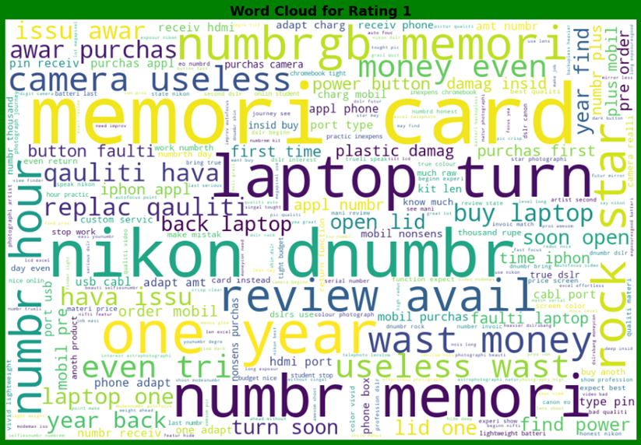
We observe for reviews with Rating 1- the most used words are numbr, memori, card, nikon, etc.

Slide 11
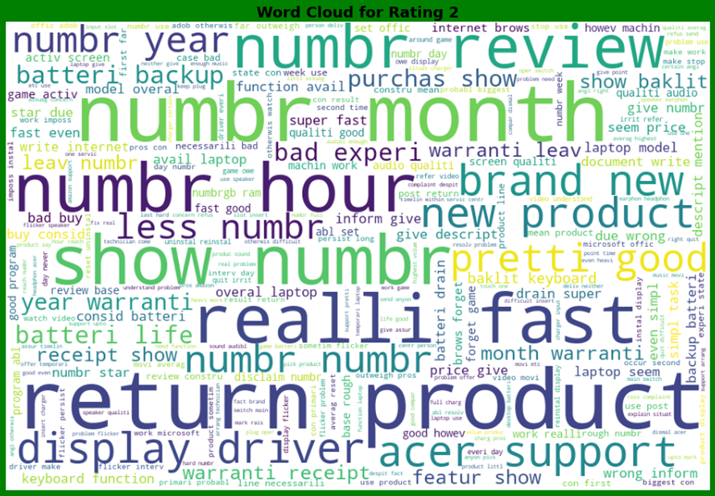
We observe for reviews with Rating 2- the most used words are return, product, numbr, realli, month, etc.

Slide 12
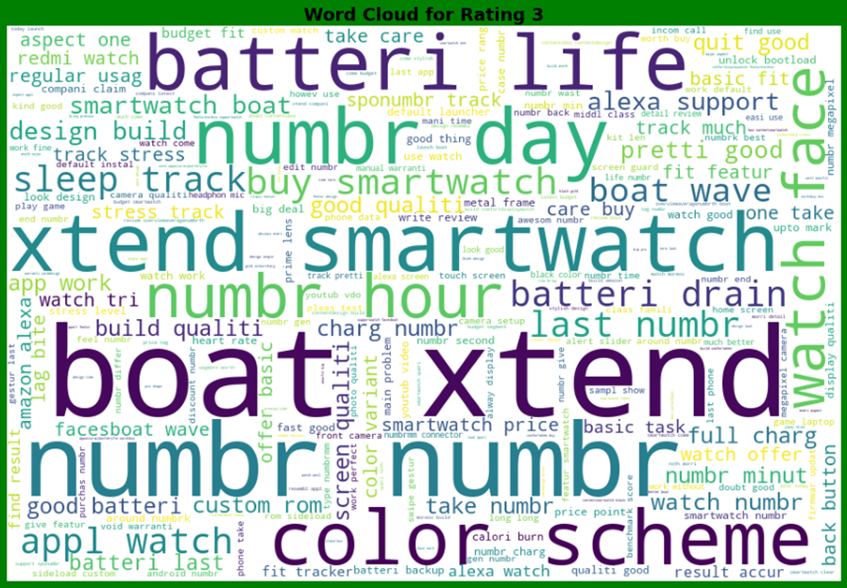
We observe for reviews with Rating 3- the most used words are boat, xtend, batteri, life, color, scheme, etc.

Slide 13
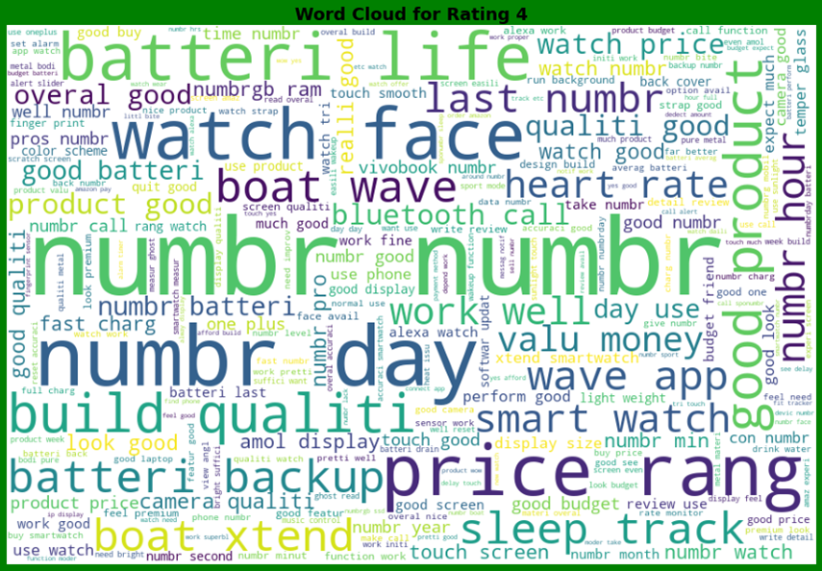
We observe for reviews with Rating 4- the most used words are numbr, day, price, rang, batteri life, etc.

Slide 14
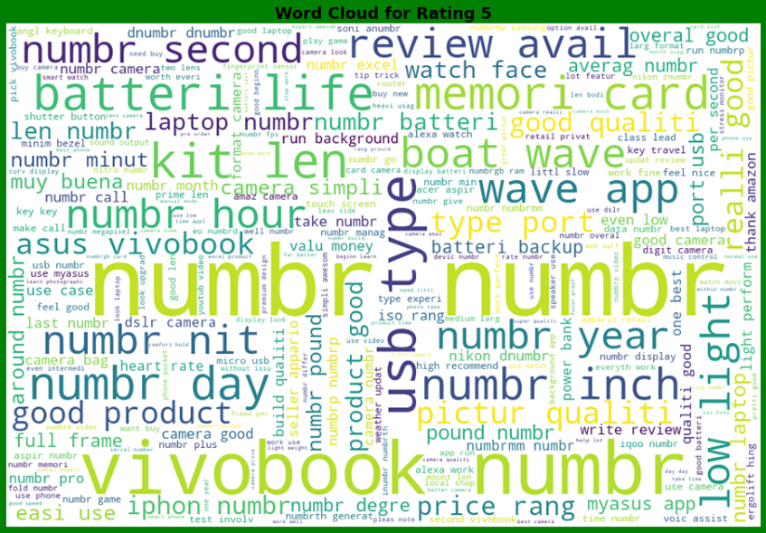
We observe for reviews with Rating 5- the most used words are numbr, vivobook, usb type, etc.

Slide 15
TESTING OF IDENTIFIED APPROACHES (ALGORITHMS)
Models | Accuracy Score
Logistic Regression | = 85.31%
Decision Tree Classifier | = 85.96%
Random Forest Classifier | = 85.98%
Ada Boost Classifier | = 63.44%
Gradient Boosting Classifier | = 83.80%
Best Model:- Random Forest Classifier

Slide 16
INTERPRETATION OF RESULTS
The data is imbalanced.
The dataset reveals that most of the people who reviewed have given 4-star rating.
After preprocessing we are able to build models for testing.
We achieved 85.98%. accuracy and hence we can say that with advanced techniques the results can be more accurate.

Slide 17
CONCLUSION
Random Forest Classifier performs better with Accuracy Score: 85.98992389323614%.
Final Model (Hyperparameter Tuning) is giving us Accuracy score of 86.11% which is slightly improved compare to earlier Accuracy score of 85.98%.
Here Random forest classifier is the most accurate algorithm as compared to others.

Slide 18
LIMITATIONS & SCOPE FOR FUTURE WORK
The data is imbalanced but we couldn’t apply balancing techniques due to computational limitations.
Deep learning CNN, ANN can be used to build more accurate models.

Slide 19


